Slide 1


BULLETIN
September 12&13
2025
Manchester Southern Asia
Sabbath Blessings

Slide 2
Song Service
Sis Padma B
Pianist – Crystal K
Welcome
Bro Aurelius K
Opening Hymn – SDAH626
In a little While we’re going Home
Opening Prayer
Bro Aurelius K
Special Song-Carolyn K
Scripture Reading-John 14:1-3
Special Music-Pr Romel Ricarte
Message – Sis Grace Ricarte
“Homeward Bound”
Closing Hymn
Jesus is coming Soon
(Troublesome Times are Here)
Closing Prayer
Sis Grace Ricarte
VESPERS - Welcoming the Sabbath

Slide 3
Song Service
Eld Johnny & Family
Pianist- Carolyn K
Welcome – Sis Rianna M
Opening Hymn – SDAH 457
I Love to tell the Story
Prayer – Sis Rianna M
Memory Verses-
Daphny, Carolyn, Joanna
Mission Story –Bro Joshua M
Special Song: Elieza B
Feature Talk - Sis Padma B
Adults Lesson Study
Bro Sujan A
Closing Song – 304
Faith of our Fathers
Closing Prayer
Bro Sujan A
SABBATH SCHOOL – Church at Study

Slide 4

Introit - SDAH 661
Holy, Holy Holy
Doxology - SDAH 660
Glory be to the Father
Invocation – Eld G Rajendran
Welcome/Open Hymn –Sis Maria K
SDAH 01 Praise to the Lord
(Tithes & Offering will be collected)
Children Story– Mrs Salomi Rajendran
Scripture Reading:Sis Octavia K
Psalms 50:21
Pastoral Prayer – Bro Devdas R
Choir response SDAH 663(Amens)
Special Song
Emelda B
Sermon –Eld G Rajendran
“Sound of Silence”
Closing Hymn – SDAH 282
I hear thy Welcome Voice
Benediction – Eld G Rajendran
Extroit – SDAH 674 Shalom
Song Leaders–Angel, Carolyn, Crystal, Joshua
Pianist – Bro Joshwin S
DIVINE SERVICE – Family Worship

Slide 5

UNWELL
Sis Rajitha, Bro Vivek, Sis Meenu, Bro Prasanna’s mother,
Bro George D
In Need of Prayers
Happy Sabbath
God Bless You

Slide 6

DIACONATE ON DUTY
Deacon in charge – Bro Devdas.R
Assistant – Bro Jasison P
Deaconess In charge – Sis Manju S
Assistant – Sis Sheela V
MEDIA TEAM
In-charge – Bro Chinnan D
Assistant – Bro John M
For your INFORMATION
CHURCH TREASURY – 06.09.2025
Sabbath School - £ 104.00
Church Offerings - £ 298.50
Church Building Fund-170.00
Church Pastor
Pr. Romel Ricarte

Slide 7

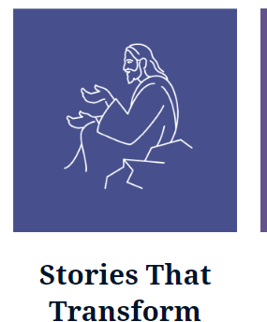


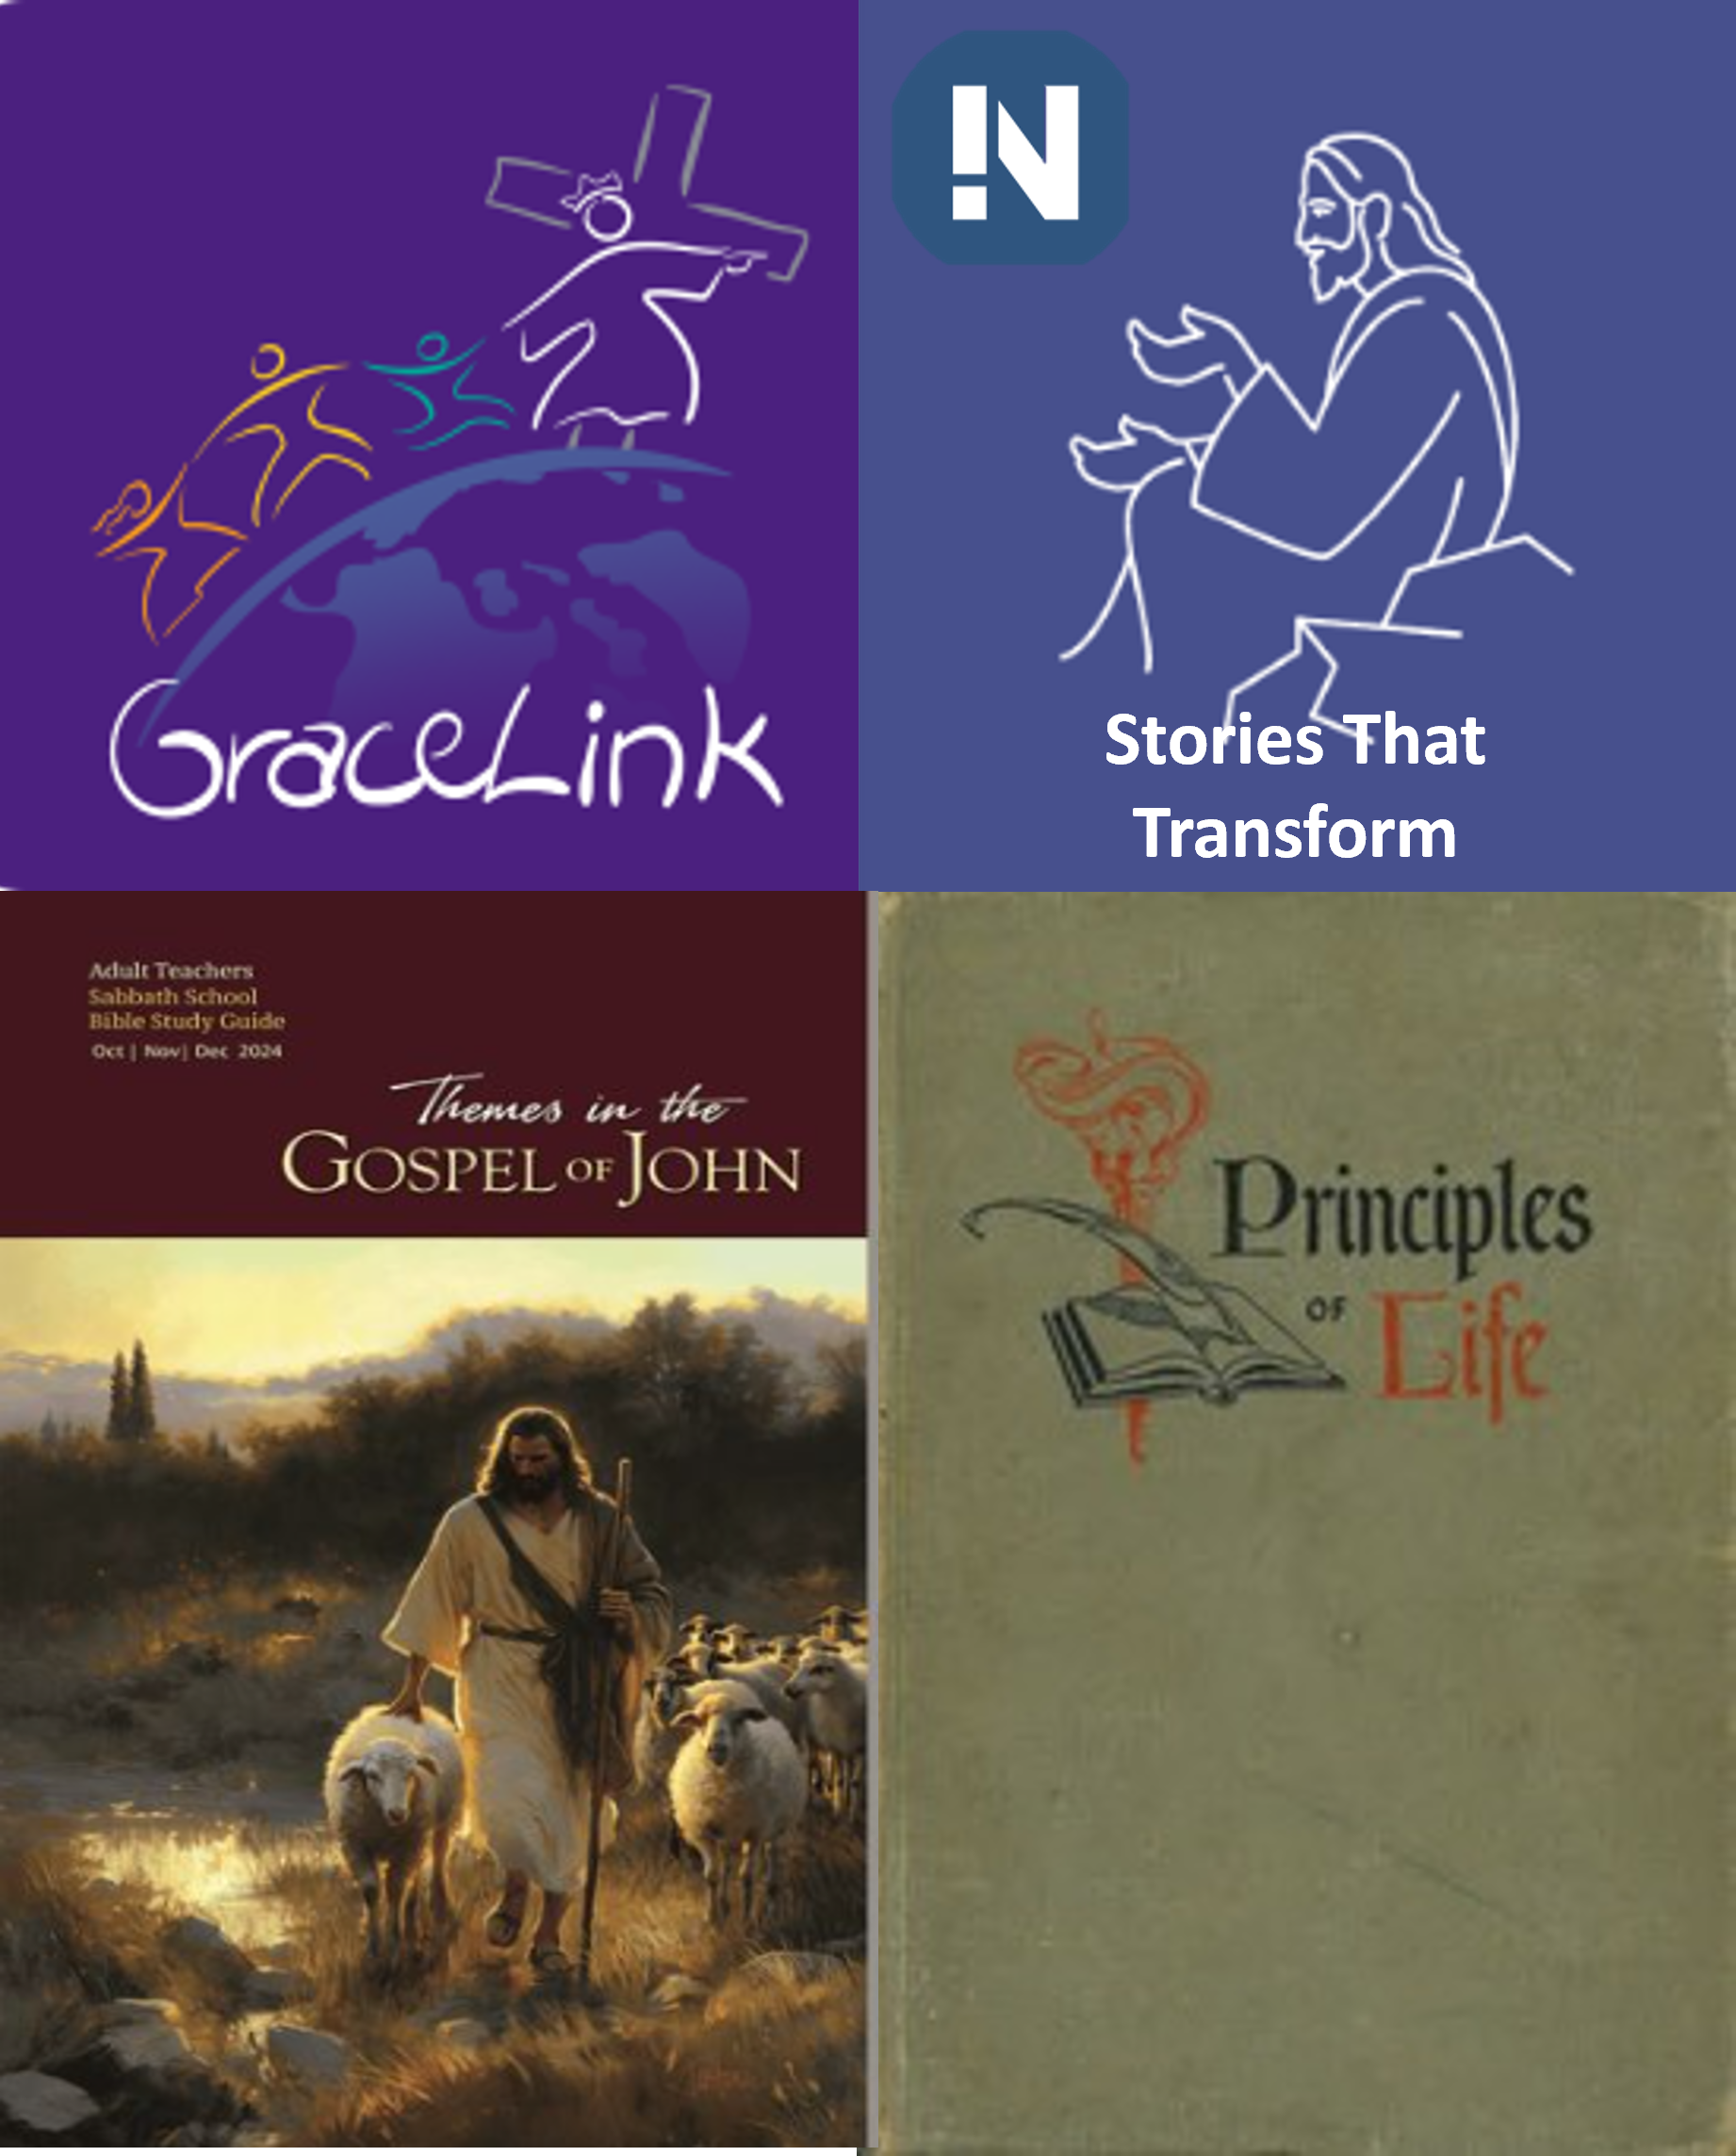
Stories That Transform

